Slide 1


DATA SCIENCE
EDUCATION
PROGRAM

Slide 2
What are we going to cover
I. | Intro to Data Science | Definition of data science Data science workflow Data science output Data science tools
II. | Live Coding | Import Data in R
 |  | Cleansing Data Exploratory Data Analysis Data Visualization Reporting in R
III. | Alumni’s Project
 |  | Customer Segmentation
 |  | Emotion Based-Tweet for Spotify Playlist Recommender Classifying Term Deposit Subscriptions
Copyright Algoritma 2021

Slide 3
Intro to Data Science
Copyright Algoritma 2021

Slide 4
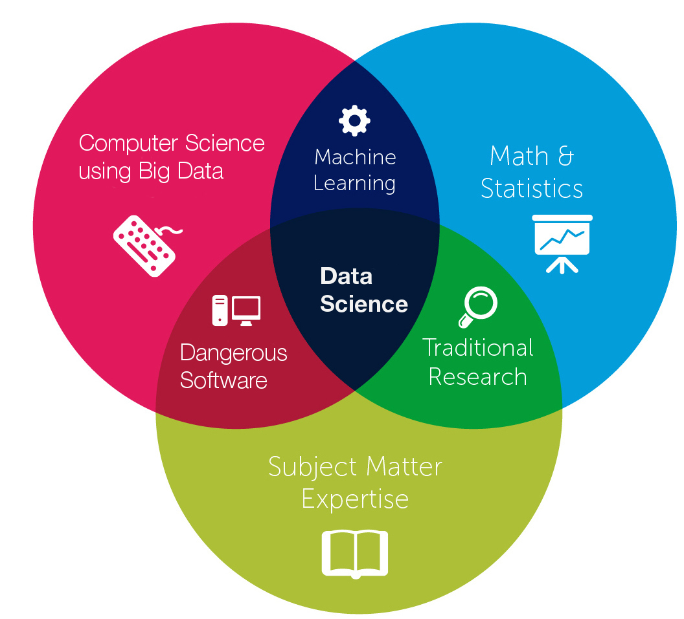
Data Science is the sweet spot of a combination of three-skills
Intro to Data Science
Copyright Algoritma 2021

Slide 5
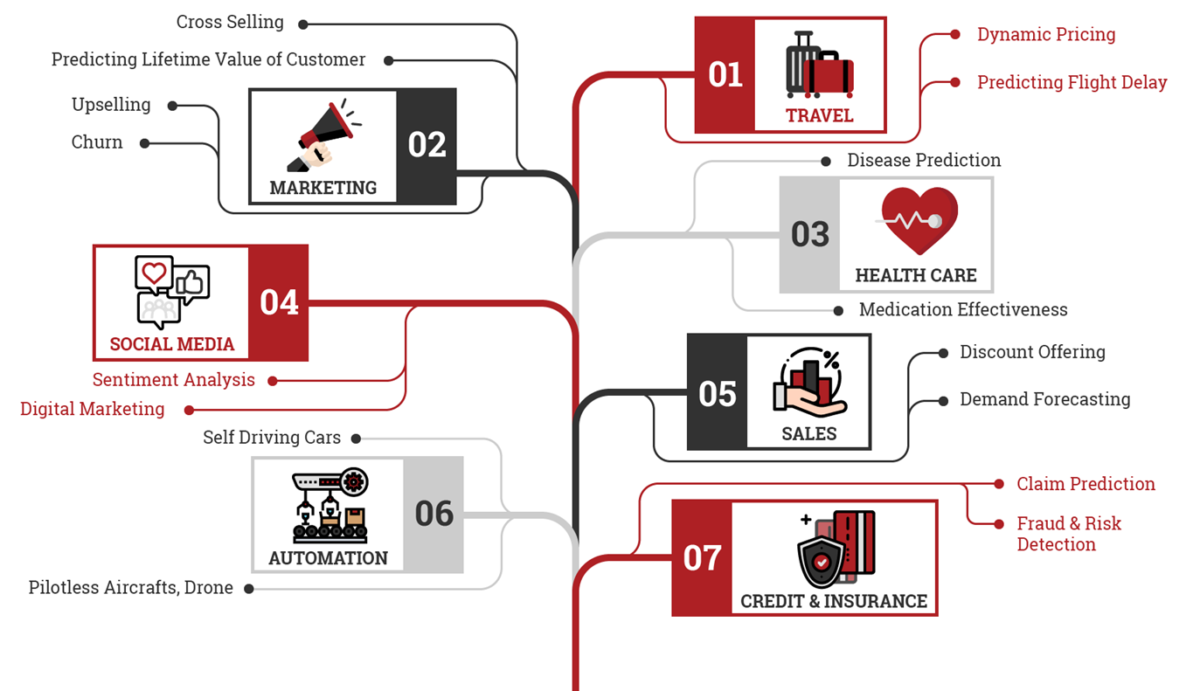
Data Science for data driven industry
Copyright Algoritma 2021

Slide 6






Common data science output
Some of the most common output from data science project are:
Reports | Presentations | Interactive Web | Apps
Guidelines:
Needs to be clearly written
Involve a narrative around the data creation of analytic dataset and its analysis
Concise conclusions
Omit unnecessary details
Reproducible
Guidelines:
Easy to use
Help pages or documentation
Code should be documented well
Code should be version controlled
Copyright Algoritma 2021

Slide 7
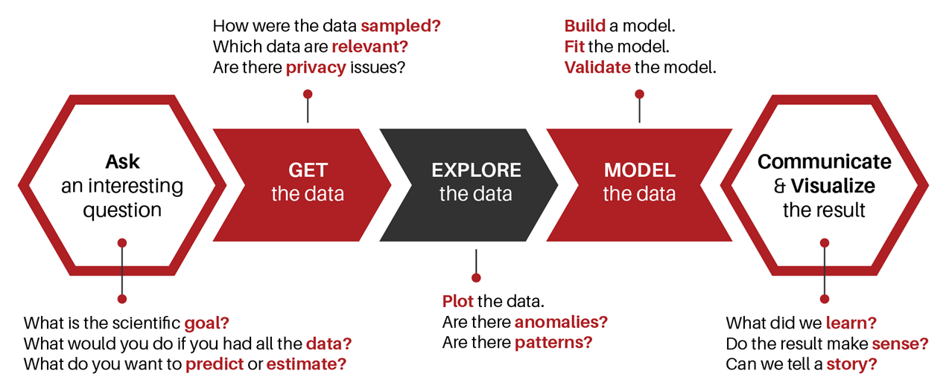
Data Sciece Workflow
Copyright Algoritma 2021

Slide 8
Data Science Tools
Data Science Tools
Copyright Algoritma 2021

Slide 9
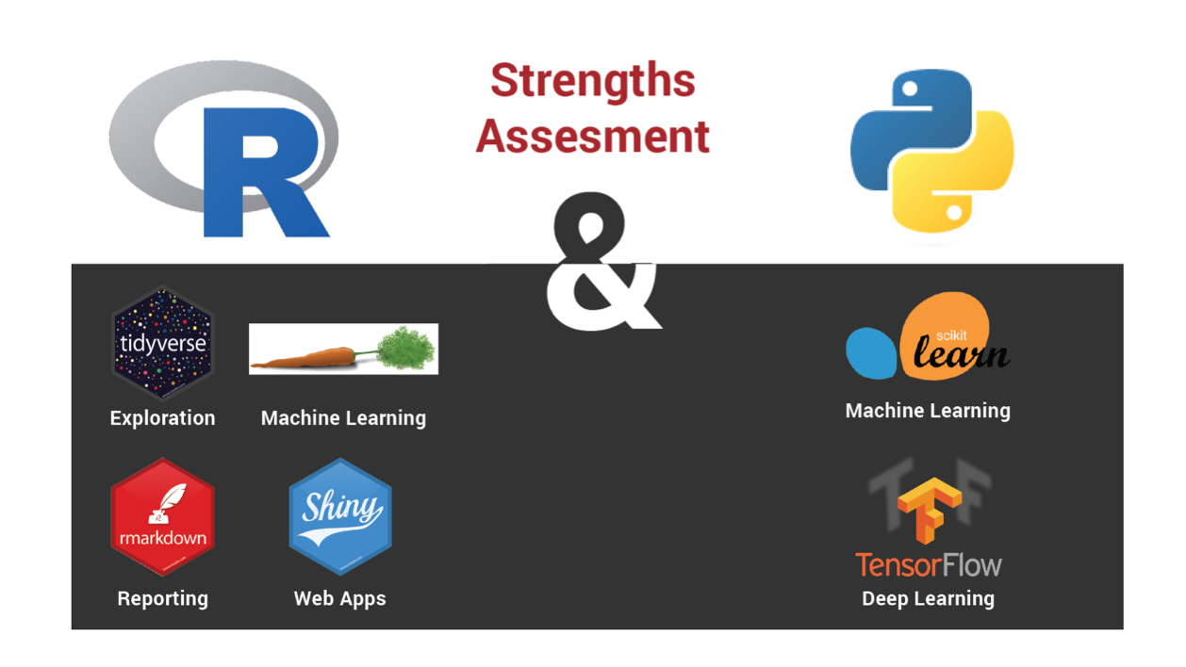
Python & R
Don’t build an “R Shop” or a “Python Shop”. Build a High Performance Data Science Team that capitalizes on the unique strengths of both languages
Copyright Algoritma 2021

Slide 10
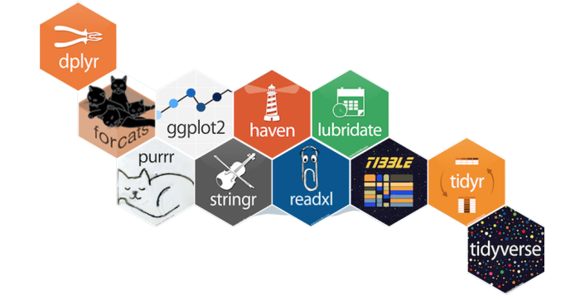
Why learn R & Python?
Open Source
R & Python widely used in data science
Newbie Friendly
Ready for Big Data
Copyright Algoritma 2021

Slide 11








Thank you
Ajeng Prastiwi
ajeng@algorit.ma
Singapore
Jakarta
Phone
+62-877-7835-3007
Singapore HQ
Cecil Court, 138 Cecil Street, 069538
Singapore
Indonesia HQ
4th Floor, Menara Kadin, Jl. H. R. Rasuna Said Blok X-5, Setiabudi, Jakarta, 12950, Indonesia
Linkedin
/teamalgoritma
Facebook
/teamalgoritma

